Slide 1
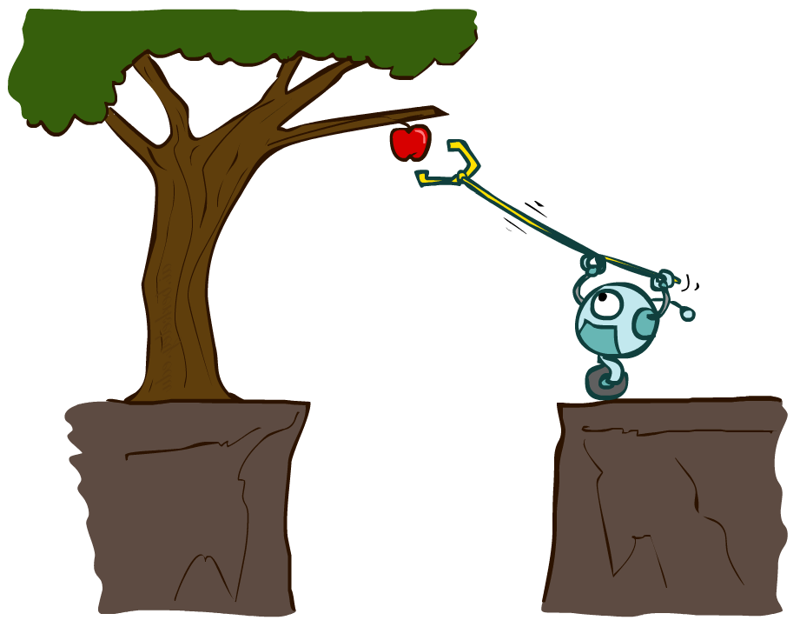
Artificial Intelligence
Agents and environments
Instructors: Stuart Russell and Dawn Song ai.berkeley.edu
Notes:
Please retain proper attribution and the reference to ai.berkeley.edu. Thanks!

Slide 2
Outline
Agents and environments
Rationality
PEAS (Performance measure, Environment, Actuators, Sensors)
Environment types
Agent types

Slide 3
Agents and environments
Agent
Environment
Sensors
Percepts
?
Actuators
Actions
An agent perceives its environment through sensors and acts upon it through actuators (or effectors, depending on whom you ask)

Slide 4
Agents and environments
Agent
Environment
Sensors
Percepts
?
Actuators
Actions
Are humans agents?
Yes!
Sensors = vision, audio, touch, smell, taste, proprioception
Actuators = muscles, secretions, changing brain state

Slide 5
Agents and environments
Agent
Environment
Sensors
Percepts
?
Actuators
Actions
Are pocket calculators agents?
Yes!
Sensors = key state sensors
Actuators = digit display

Slide 6
Agent functions
The agent function maps from percept histories to actions:
f : P* → A
I.e., the agent’s actual response to any sequence of percepts
Percept
NEXT
NEXT
NEXT
NEXT
Action
LEFT
LEFT
DROP
RIGHT
Notes:
Is there any reason to pay attention to more than just the current percept?
No – the correct decision depends only on the current percept because the world is fully observable!

Slide 7
Agent programs
The agent program l runs on some machine M to implement f :
f = Agent(l,M)
Real machines have limited speed and memory, introducing delay, so agent function f depends on M as well as l
Percept
NEXT
NEXT
NEXT
NEXT
Action
NOOP
NOOP
NOOP
LEFT

Slide 8
Example: Vacuum world
Percepts: [location,status], e.g., [A,Dirty]
Actions: Left, Right, Suck, NoOp

Slide 9
Vacuum cleaner agent
Agent function
Agent program
Percept sequence | Action
[A,Clean] | Right
[A,Dirty] | Suck
[B,Clean] | Left
[B,Dirty] | Suck
[A,Clean],[B,Clean] | Left
[A,Clean],[B,Dirty] | Suck
etc | etc
function Reflex-Vacuum-Agent([location,status])
returns an action
if status = Dirty then return Suck
else if location = A then return Right
else if location = B then return Left
What is the right agent function?
Can it be implemented by a small agent program?
(Can we ask, “What is the right agent program?”)

Slide 10
Rationality
Fixed performance measure evaluates the environment sequence
one point per square cleaned up?
NO! Rewards an agent who dumps dirt and cleans it up
one point per clean square per time step, for t = 1,…,T
A rational agent chooses whichever action maximizes the expected value of the performance measure
given the percept sequence to date and prior knowledge of environment
Does Reflex-Vacuum-Agent implement a rational agent function?
Yes, if movement is free, or new dirt arrives frequently
Notes:
The dirt-dumping problem is an example of the King Midas problem – mis-specifying the objective

Slide 11
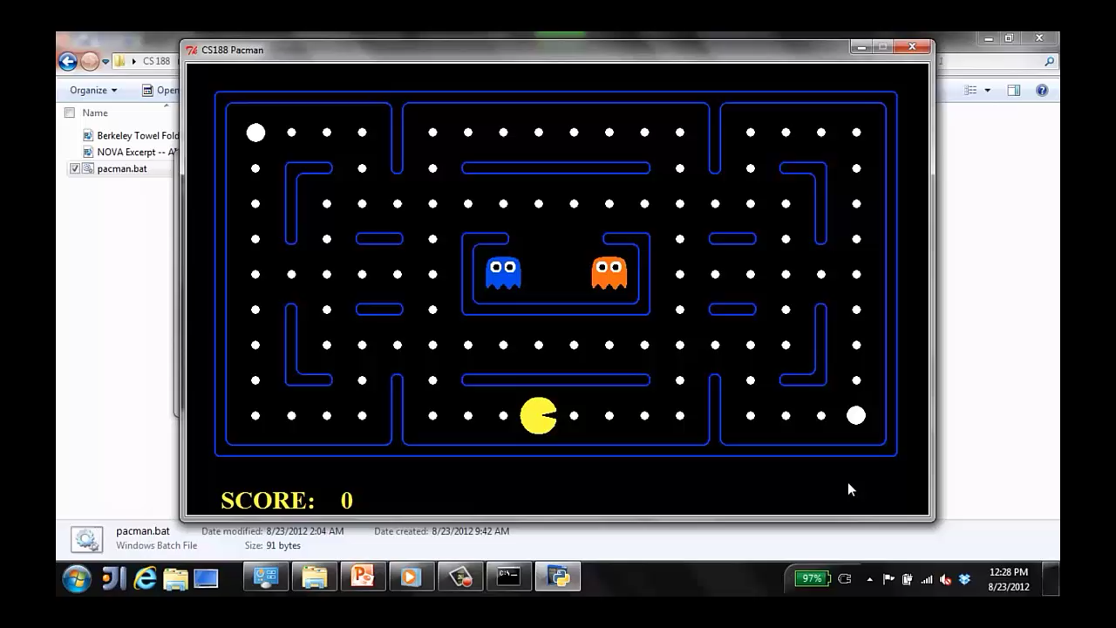
A human agent in Pacman

Slide 12
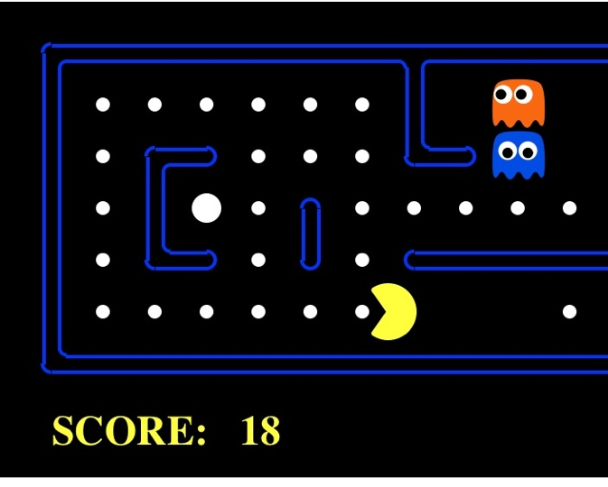
The task environment - PEAS
Performance measure
-1 per step; + 10 food; +500 win; -500 die; +200 hit scared ghost
Environment
Pacman dynamics
Actuators
Left Right Up Down
Sensors
Entire state is visible

Slide 13
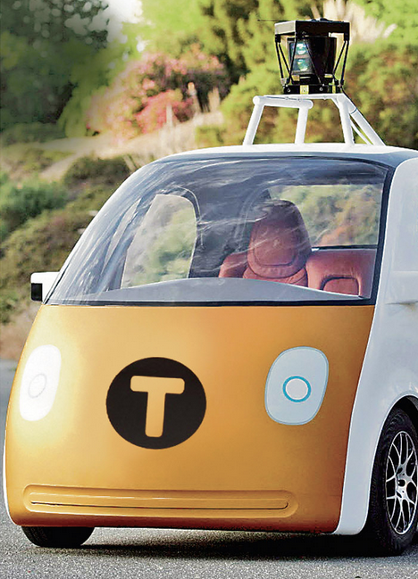
PEAS: Automated taxi
Performance measure
Income, happy customer, vehicle costs, fines, insurance premiums
Environment
streets, other drivers, customers, weather, police…
Actuators
Steering, brake, gas, display/speaker
Sensors
Camera, radar, accelerometer, engine sensors, microphone, GPS
Image: http://nypost.com/2014/06/21/how-google-might-put-taxi-drivers-out-of-business/

Slide 14
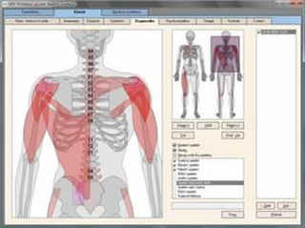
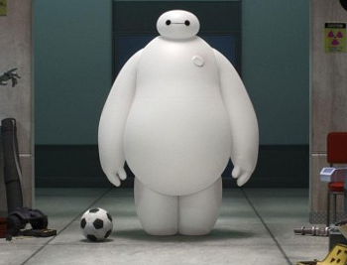
PEAS: Medical diagnosis system
Performance measure
Patient health, cost, reputation
Environment
Patients, medical staff, insurers, courts
Actuators
Screen display, email
Sensors
Keyboard/mouse

Slide 15
More Examples
Agent | Performance Measure | Environment | Actuator | Sensor
Hospital Management System | Patient’s health, Admission process, Payment | Hospital, Doctors, Patients | Prescription, Diagnosis, Scan report | Symptoms, Patient’s response
Automated Car Drive | Comfortable trip, Safety, Maximum Distance | Roads, Traffic, Vehicles | Steering wheel, Accelerator, Brake, Mirror | Camera, GPS, Odometer
Subject Tutoring | Maximize scores, Improvement is students | Classroom, Desk, Chair, Board, Staff, Students | Smart displays, Corrections | Eyes, Ears, Notebooks
Part -picking Robot | Percentage of parts in correct bins | Conveyor belt with parts, Bins | Jointed Arms, Hand | Camera, Joint angle, sensors

Slide 16
Summary
An agent interacts with an environment through sensors and actuators
The agent function, implemented by an agent program running on a machine, describes what the agent does in all circumstances
Rational agents choose actions that maximize their expected utility
PEAS descriptions define task environments; precise PEAS specifications are essential and strongly influence agent designs
More difficult environments require more complex agent designs and more sophisticated representations

